Slide 1
NOTIFICATION OF A SEXUALLY VIOLENT PREDATOR MOVING TO CAÑON CITY

Slide 2
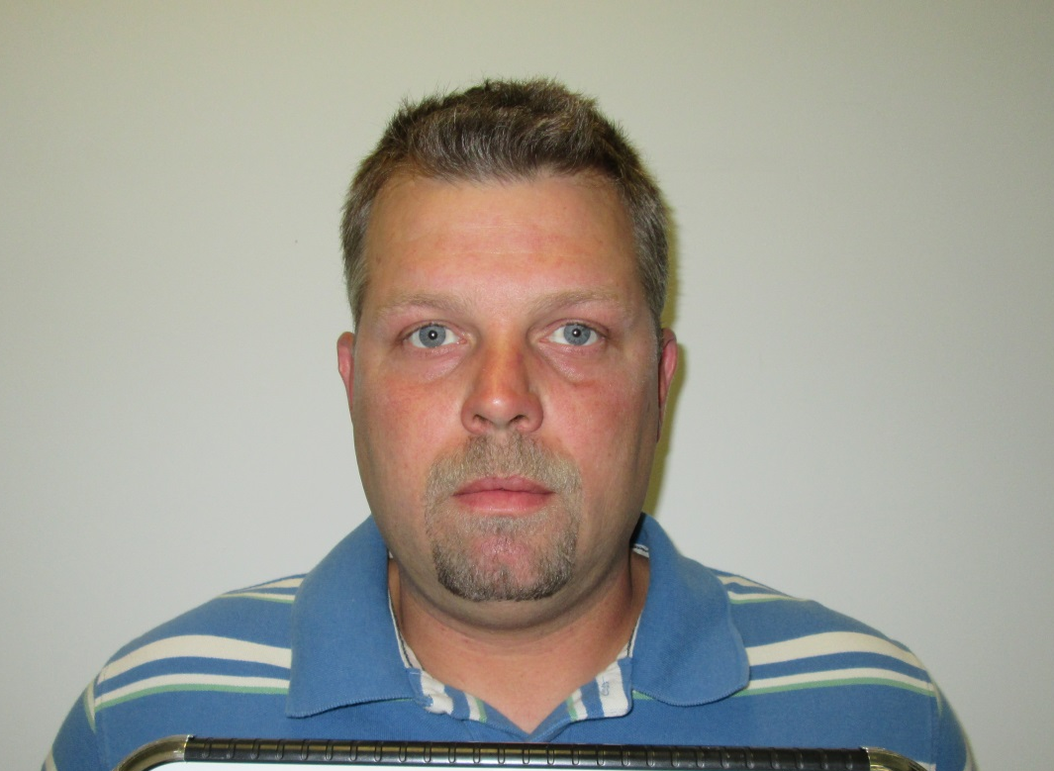
William Joseph, “Jody”, Drake
Conviction: Sexual Assault on a Child, Class 4 Felony
White Male, 6’ 00” 185 pounds Brown Hair, Blue Eyes
Date of birth, 08/25/1978
Address: 1015 Harding Avenue, Cañon City, CO 81212

Slide 3
PLEASE REMEMBER:
Vigilantism, harassment, threats or intimidation of the Offender is counter-productive to the best interests and safety of the community. We want Sexually Violent Predators to be:
Registered and visible in the community.
We do not want the SVP to go into hiding or fail to register with Law Enforcement.

Slide 4
If anyone attempts to harass, threaten or intimidate the Offender in any way, ,they will be subject to criminal charges.

Slide 5
COMMUNITY PROTECTION & SAFETY ISSUES:
What can I tell my children about the SVP?
Avoid Scary details.
Use language that is honest and age appropriate.
Teach your children not to harass or visit the Offender’s home or yard.

Slide 6
Teach your children to TELL a SAFE ADULT if anyone acts inappropriately towards them. (Creepy, too friendly, threatening etc.

Slide 7
COMMUNITY PROTECTION & SAFETY ISSUES CONTINUED:
Pay attention to your child’s thoughts and feelings.
Role play with your child: Act out scenarios of various dangerous situations and teach them how to respond.
Avoid high risk situations.
Be observant of your surroundings.
Be thoughtful and use good judgement when choosing friends or partnets.

Slide 8
COMMUNITY PROTECTION & SAFETY ISSUES CONTINUED:
Teach appropriate social behaviors
Do not put personal information or photos on any social websites.
Teach correct names for body parts.
Teach children that adults are NOT ALWAYS RIGHT.
Teach the importance of honesty and the danger of keeping secrets.

